Slide 1
LED
Light Emitting Diodes
Dr. S. RANJITH / Physics, SRM IST

Slide 2
Light Emitting Diodes
LED (Light Emitting Diode) is a semiconductor p-n junction diode which
Converts electrical energy to light energy under forward biasing.
Principle
The diode is forward biased. Due to forward bias, the majority carriers from
‘n’ and ‘p’ regions cross the junction and become minority carriers in the other
junction (i.e.) Electrons, which are majority carriers in ‘n’ region cross the
Junction and go to ‘p’ region and become minority carriers in p-region
Similarly, holes which are majority carries in ‘p’ region cross the junction
and go to ‘n’ region and become minority carriers in ‘n’ region and this
Phenomenon is called minority carrier injection.
Dr. S. RANJITH / Physics, SRM IST

Slide 3
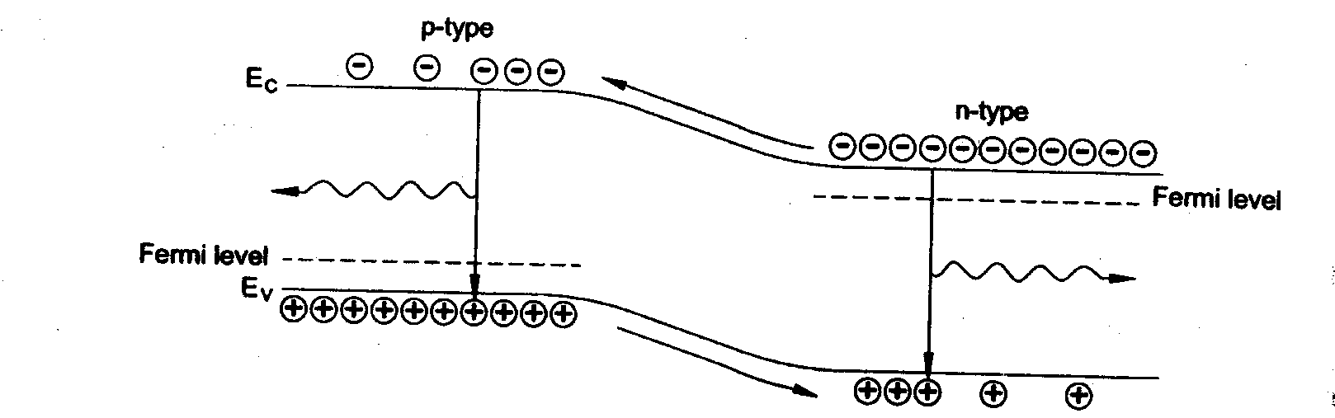
Radiative recombination
Now if the biasing voltage is further increased, these excess minority carriers
diffuse away from the junction and they directly recombine with the majority
carriers. (i.e.) the electrons, which are excess minority carriers in p-region
recombine with the holes which are the majority carriers in ‘p’ region and emit
light. Similarly, the holes which are excess minority carriers in ‘n’ region
recombine with the electrons which are majority carriers in ‘n’ region and
emit light.
Dr. S. RANJITH / Physics, SRM IST

Slide 4
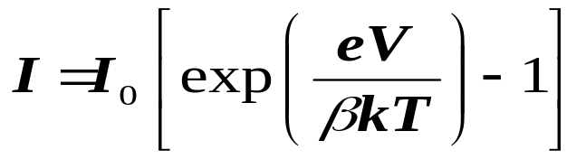
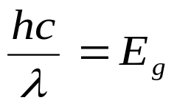
Thus radiative recombination events lead to photon emission. The number of radiative recombination is proportional to the carrier injection rate and hence to the total current flowing through the device as given by
where I₀ - the saturation current ; V- the forward bias voltage;
k - the Boltzmann constant ; β -varies from 1 and 2 depending on the
semiconductor and temperature.
The optical photon emitted due to radiative recombination has the energy
very close to the bandgap energy E_{g} and frequency of the emitted photon is
given by
where λ - the photon wavelength; h - Plancks constant; c - the velocity of light in vacuum.
Dr. S. RANJITH / Physics, SRM IST

Slide 5
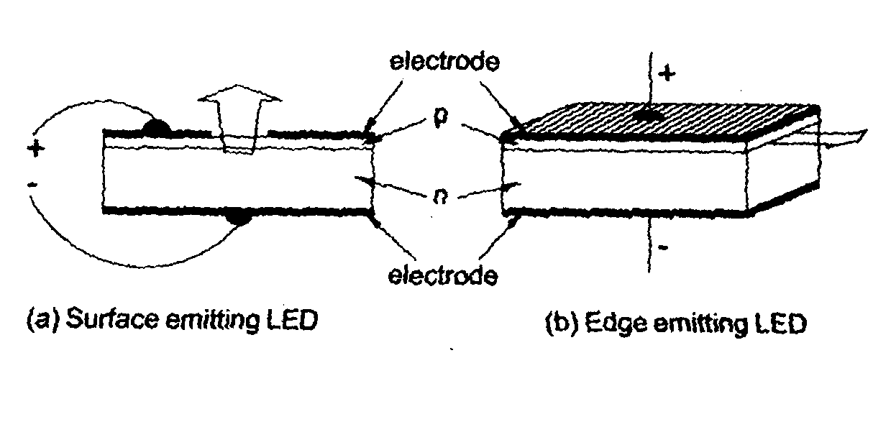
LED Construction
An LED must be constructed such that the light emitted by the radiative recombination events can escape the structure.
Sketches of LEDs
LEDs can be designed as either surface or edge emitters. Surface emitting LEDs can be made such that the bottom edge reflects light back towards the top surface to enhance the output intensity. The main advantage of edge emitter LEDs is the emitted radiation is relatively direct. Hence edge emitter LEDs have a higher efficiency in coupling to an optical fibre.
Dr. S. RANJITH / Physics, SRM IST

Slide 6
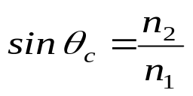
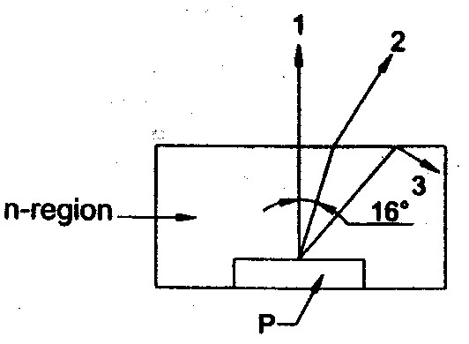
Although the internal quantum efficiency of LEDs is 100%, the external efficiencies are much lower. The main reason is that most of the emitted light radiation strikes the material interface at greater than critical angle and hence trapped with in the device. The internal critical angle at the semiconductor air boundary is given by
Where n₁­ is the refractive index of air = 1.0
n₂ is the refractive index of the semiconductor
For group III semiconductor n₂ = 3.5
Therefore θ_{c} = 16°
Therefore all rays of light striking the surface at an angle exceeding 16° suffer total internal reflection and as a result most of the emitted light is reflected back inside the semiconductor crystal.
Critical angle
Dr. S. RANJITH / Physics, SRM IST

Slide 7
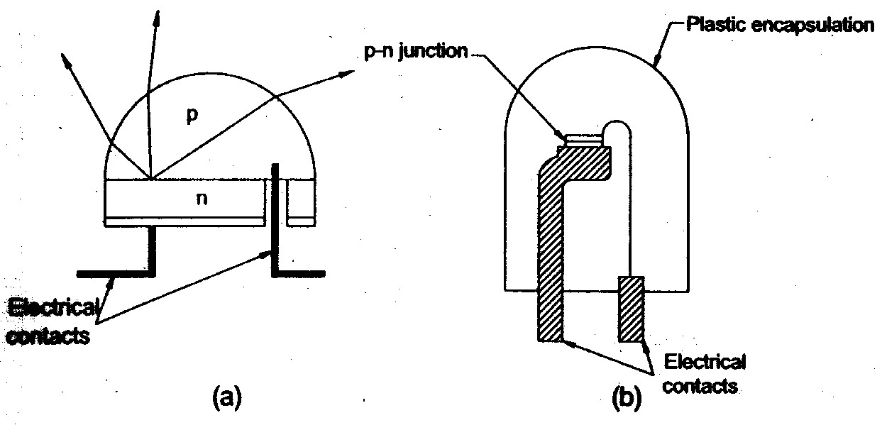
Two methods used to reduce reflection losses in LEDs
Hence to improve the external efficiency losses caused bulk absorption has to be minimized and the surface transmission has to be increased. One method to achieve this is to give the semiconductor a dome structure.
Hemi spherical domes made from plastics are effective in increasing the external efficiency by a factor 2 or 3. There will be some losses at the plastic/ air interface but these are easily minimized by molding the plastic into an approximately hemispherical shape.
Dr. S. RANJITH / Physics, SRM IST

Slide 8
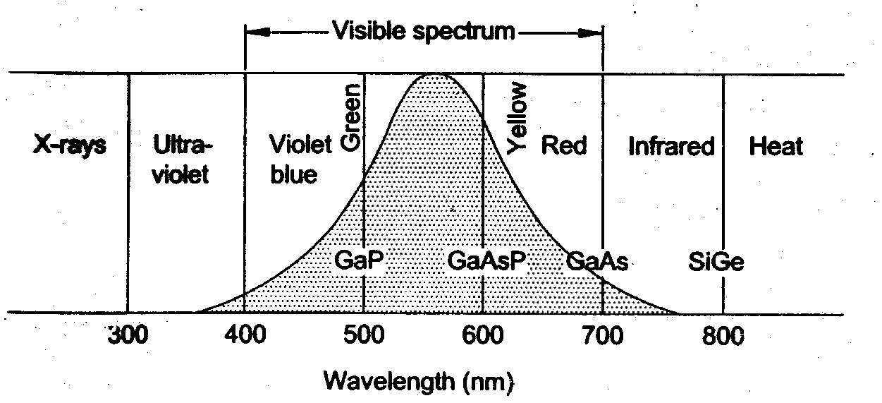
Materials
The choice of the materials for an LED is decided by the spectral requirements for a particular application. The most commonly used materials for LEDs are GaP, GaAs and their related ternary compound
Ga As_{x} P_{1-x}
The bandgap radiation of GaP, GaAs and GaAsP. GaP which gives a peak at 560 nm is very close to the wavelength of maximum eye response.
This makes GaP one of the most useful of all visible semiconductor light sources since in addition to green light both red and other colours can be produced by appropriate dopants.
Material | Dopant | Bandgap (eV) | Wavelength ( Nm) | Quantum efficiency ( %)
GaP GaP GaP GaAs AlGa | N Zn0 N P As | 2.88 1.80 2.25 1.88 1.84 | 430 690 550 660 675 | 0.6 0.2 0.1 0.2 0.2
Wavelength response of LED materials
Dr. S. RANJITH / Physics, SRM IST

